Slide 1
NCI-CBITT
George Zaki and Peng Wang

Slide 2
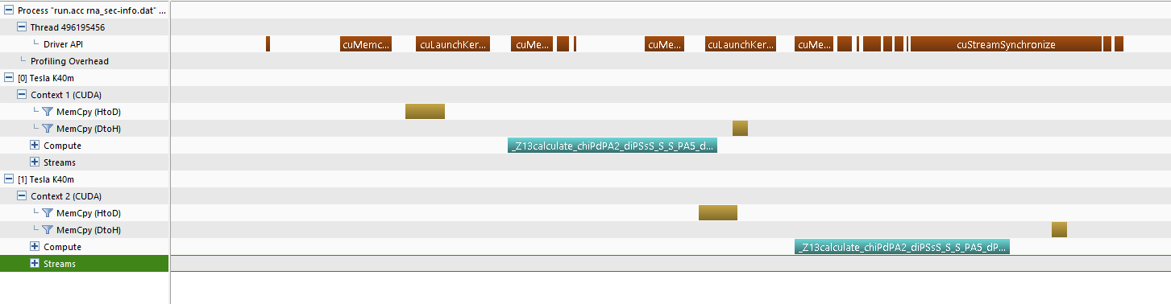
Yesterday

Slide 3
#pragma omp parallel for
for (mygpu=0; mygpu<ngpu; mygpu) {
istart=..., iend=...;
acc_set_device_num(mygpu);
#pragma acc update device(input);
#pragma acc parallel loop
for (...)
#pragma acc update host(output[istart:iend]);
}

Slide 4
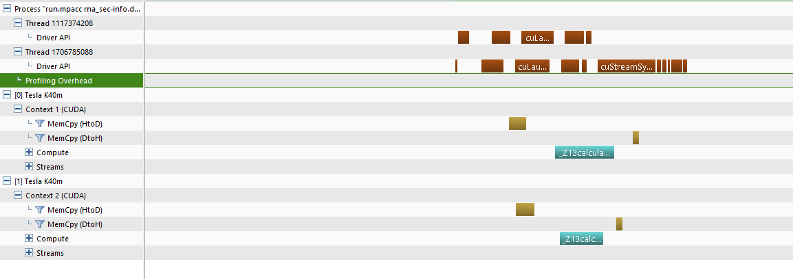

Slide 5
But
Runtime doesn’t decrease
Likely due to OpenMP overhead
Result is wrong
tried many variations: rm async; restructure loop; wait, use cudaMemcpy, etc.
correct most of the time, but fail to copy results back in ~50 out of 100000 iterations: result array is just 0
likely is a runtime/compiler bug

Slide 6
GPU Part Speedup: 43%
Elapsed time for compute routine
memcpy, kernel, launch overhead, sync, etc

Slide 7
OpenACC Performance

Slide 8
OpenACC vs OpenMP
Intel E5-2650 v2
K40

Slide 9
CUDA Version
Integrated the base CUDA version
host_data use_device works for pointer math
Compile
a = gpu_array;
b = gpu_array + 60;
#pragma acc host_data use_device(a,b)
{
my_awesome_cuda_kernel(a,b);
}

Slide 10
Another RNA Image Analysis Code
In IDL
so probably “not suck” is easy
Break 1024x1024 image into 10x10 tiles, call analysis routine on each tile
Figured out the parallelization scheme
One block for one tile

Slide 11
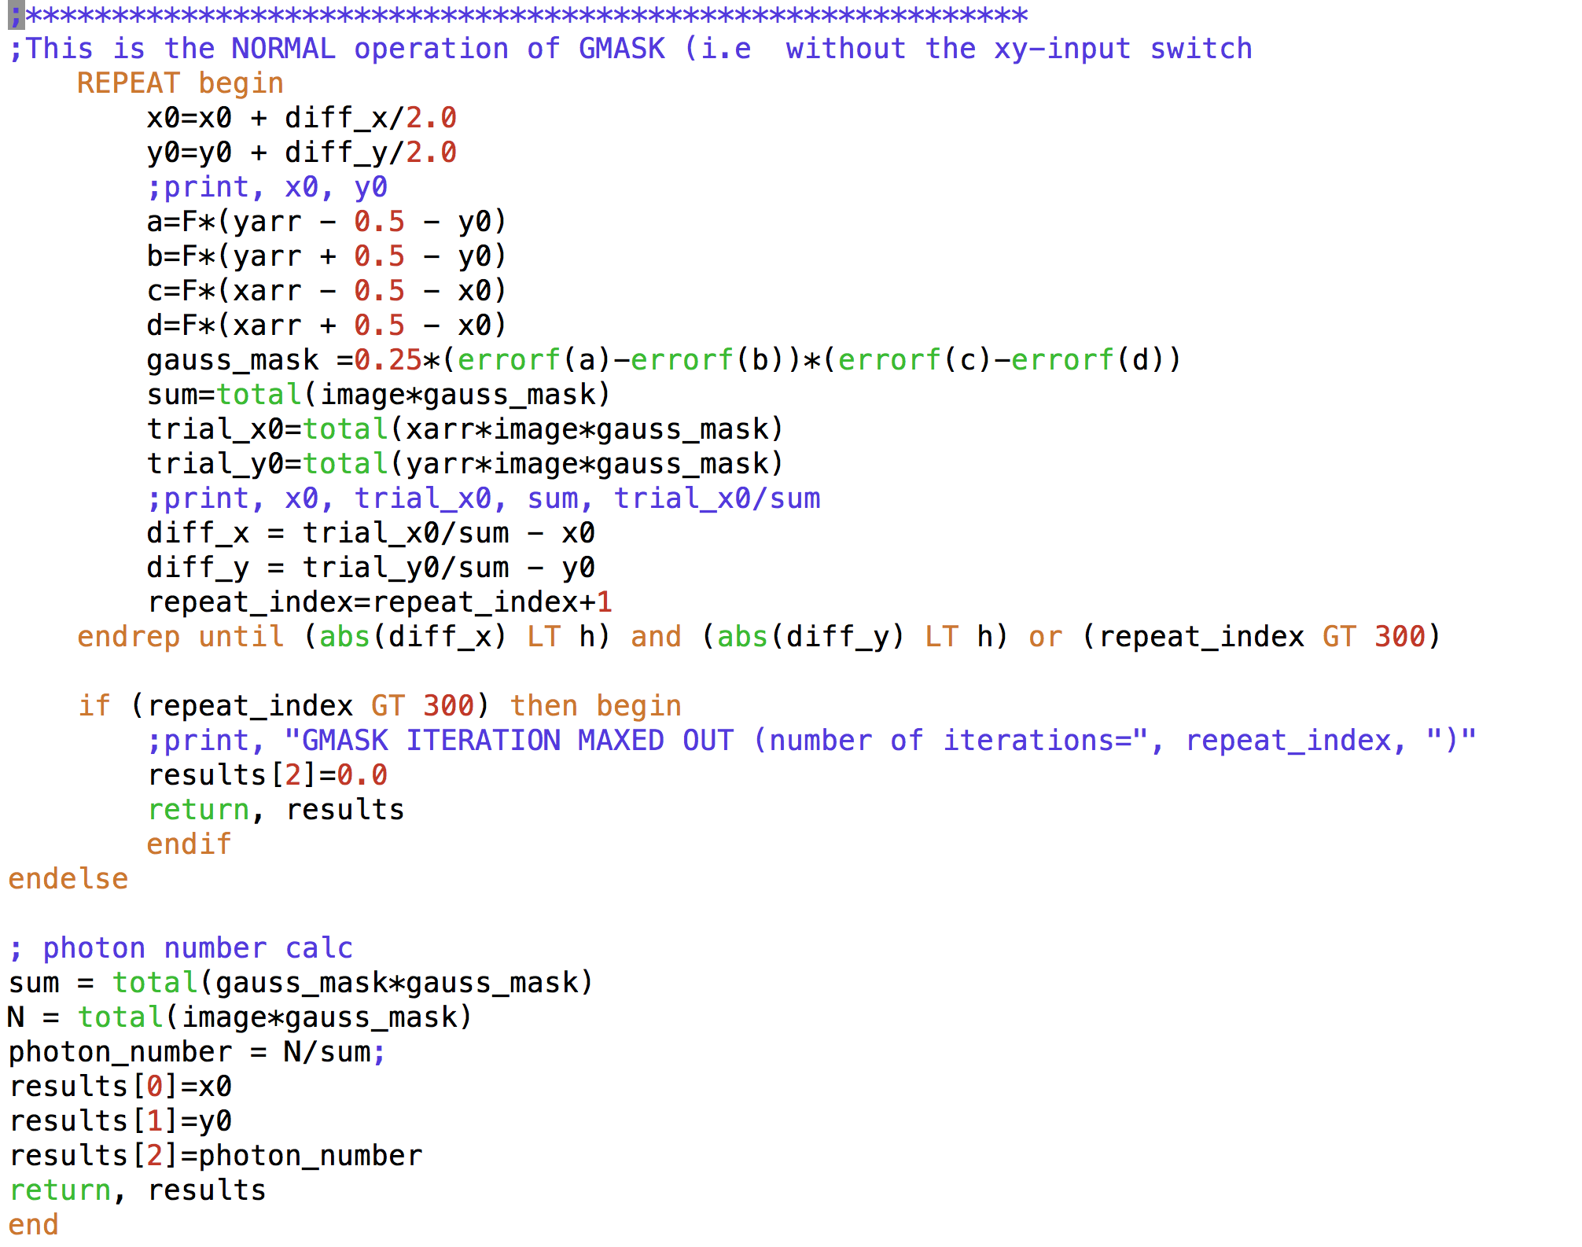

Slide 12
Next Step
Finish/enhance the CUDA version
Port/optimize the IDL code

